Slide 1
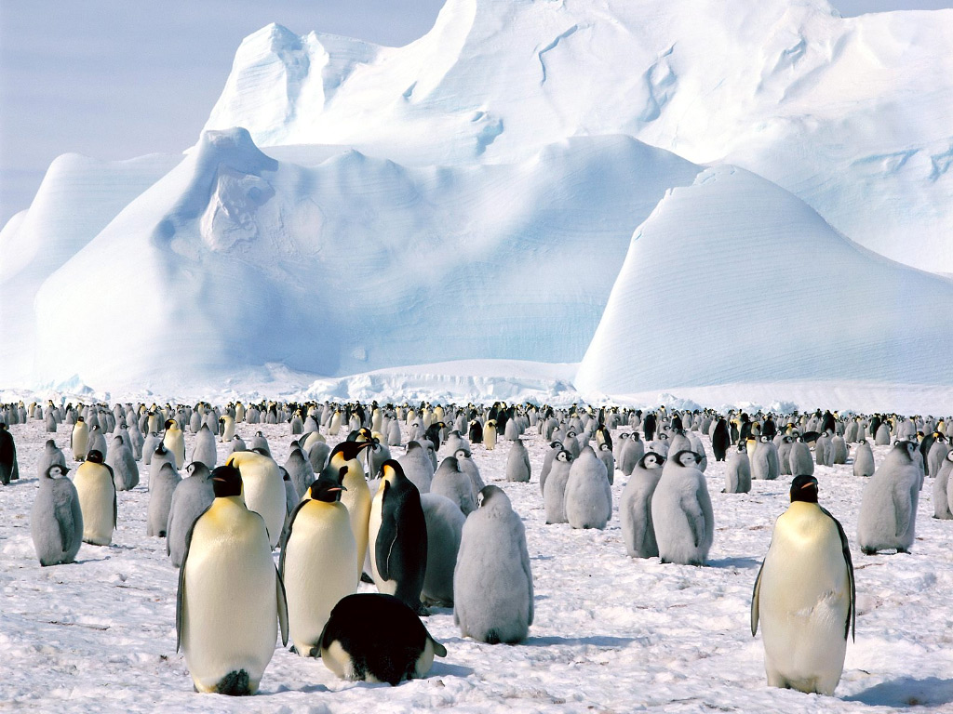




Seasonal Anomalies in the Sea Ice Concentration in the Ross Sea and Their Correlation to the Southern Annular Mode
Kiley Yeakel¹, Joellen Russell², Paul Goodman²
21st Annual Arizona/NASA Statewide Space Grant Symposium
April 20 - 21, 2012
Tucson, Arizona
¹Dept. of Chemical and Environmental Engineering, University of Arizona
²Geosciences Dept., University of Arizona
http://artsonearth.com/2010/05/antarctica-versus-global-warming.html

Slide 2
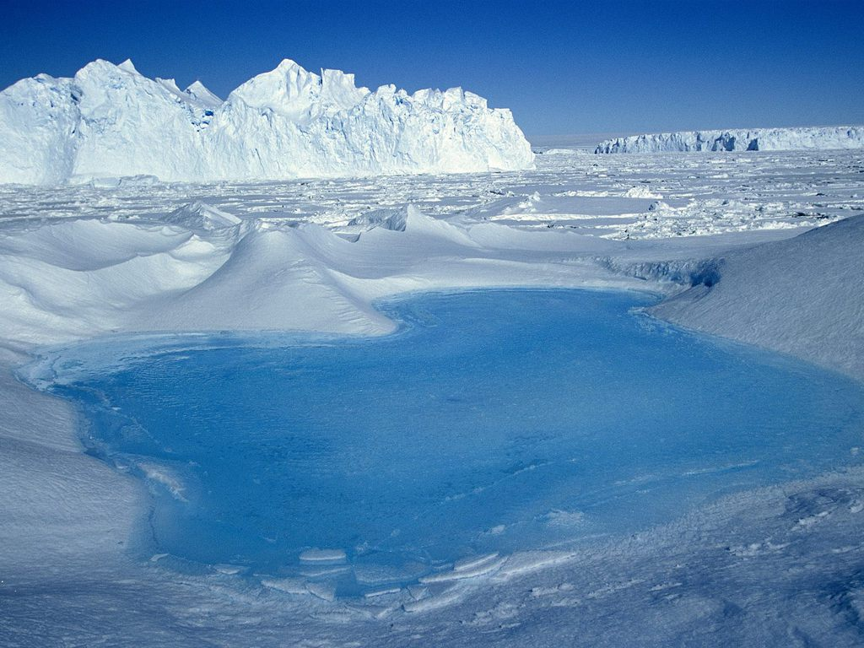
Goals of this Study
Develop a climatology for the Ross Sea
Correlate mechanisms of sea ice formation/degradation with the Southern Annular Mode
  Local winds
  Surface water temperature
Hypothesize on future conditions of sea ice in the Ross Sea
http://images.search.yahoo.com/search/images?p=antarctica%20wallpaper

Slide 3
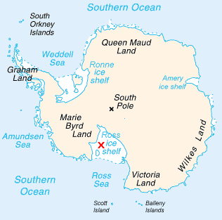
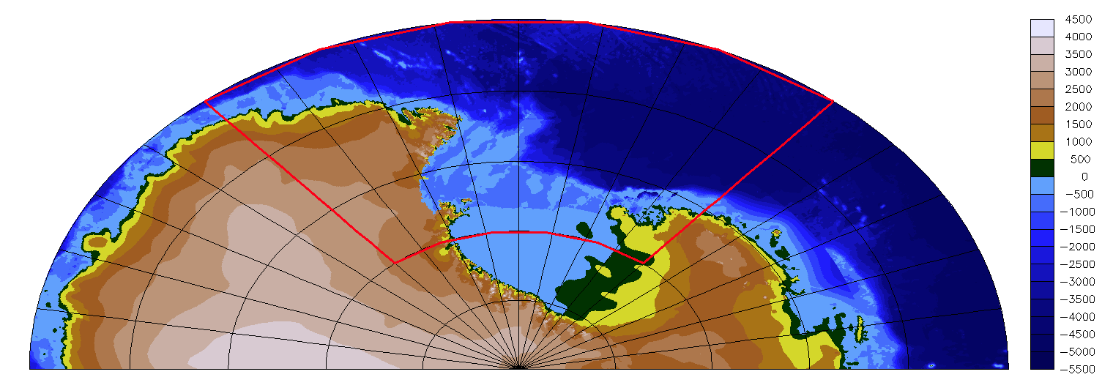
The Ross Sea
Extensive permanent ice shelf extending from the southernmost part of the sea to 80° Latitude
Relatively pristine sea
Focus of environmental conservation groups
  Important habitant for marine species
https://www.cia.gov/library/publications/the-world-factbook/geos/ay.html
Study area (highlighted in right image):
140° E to 220° E
80° S to 65° S

Slide 4
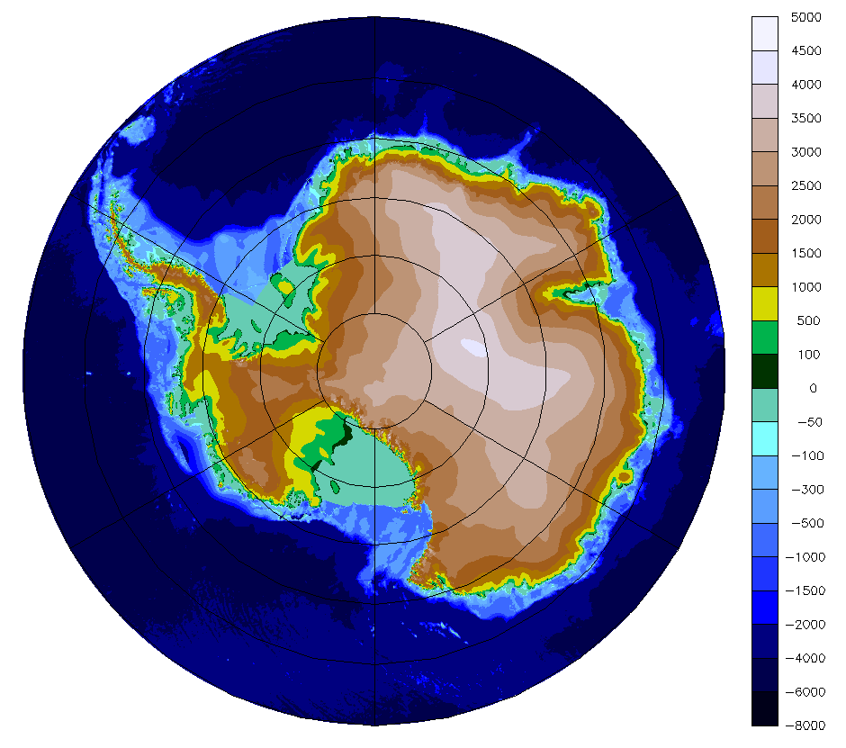
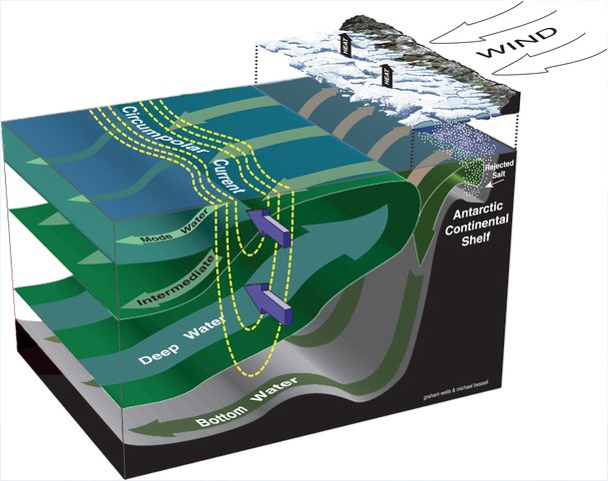
Climate of the Ross Sea and Antarctica
Katabatic winds: Cold, dense air flows downslope off high topography at center of Antarctica towards the coast
Circumpolar winds drive upwelling by Ekman transport

Slide 5
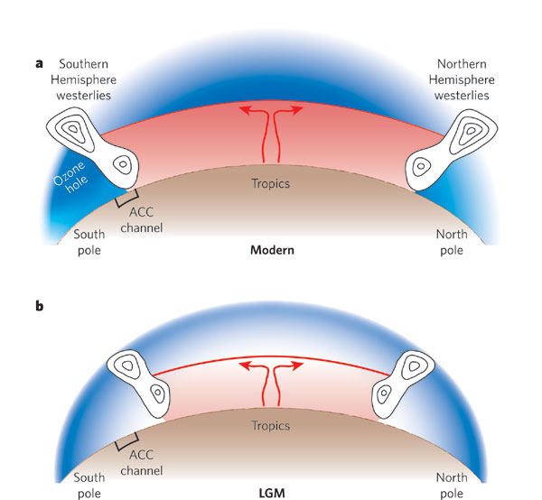
The Southern Annular Mode
SAM is measure of the pole-ward shift and intensification of the circumpolar atmospheric low-pressure trough
Toggweiler & Russell, 2008
Notes:
Bands of westerly winds in the Northern Hemisphere and Southern Hemisphere (shown schematically by the isotachs) separate the warm air (red shades) in the tropics from the cold air (blue shades) over the poles. a, Atmospheric structure today. Over recent decades, higher CO₂ concentrations have made the warm air warmer and the surrounding envelope of cold air cooler, especially near the top of the troposphere (curved red line). The thermal contrast across the zones of strong westerlies in the Northern and Southern Hemispheres is therefore greater, and the westerlies have become stronger and have shifted polewards in response. b, Proposed atmospheric structure at the LGM. With less CO₂ in the atmosphere, the thermal contrast in the middle of the atmosphere was probably decreased (indicated by paler shades), and the westerlies aloft should therefore have been relatively weak. The strongest westerlies were also significantly north of the ACC, where they would have had much less impact on the ocean.

Slide 6
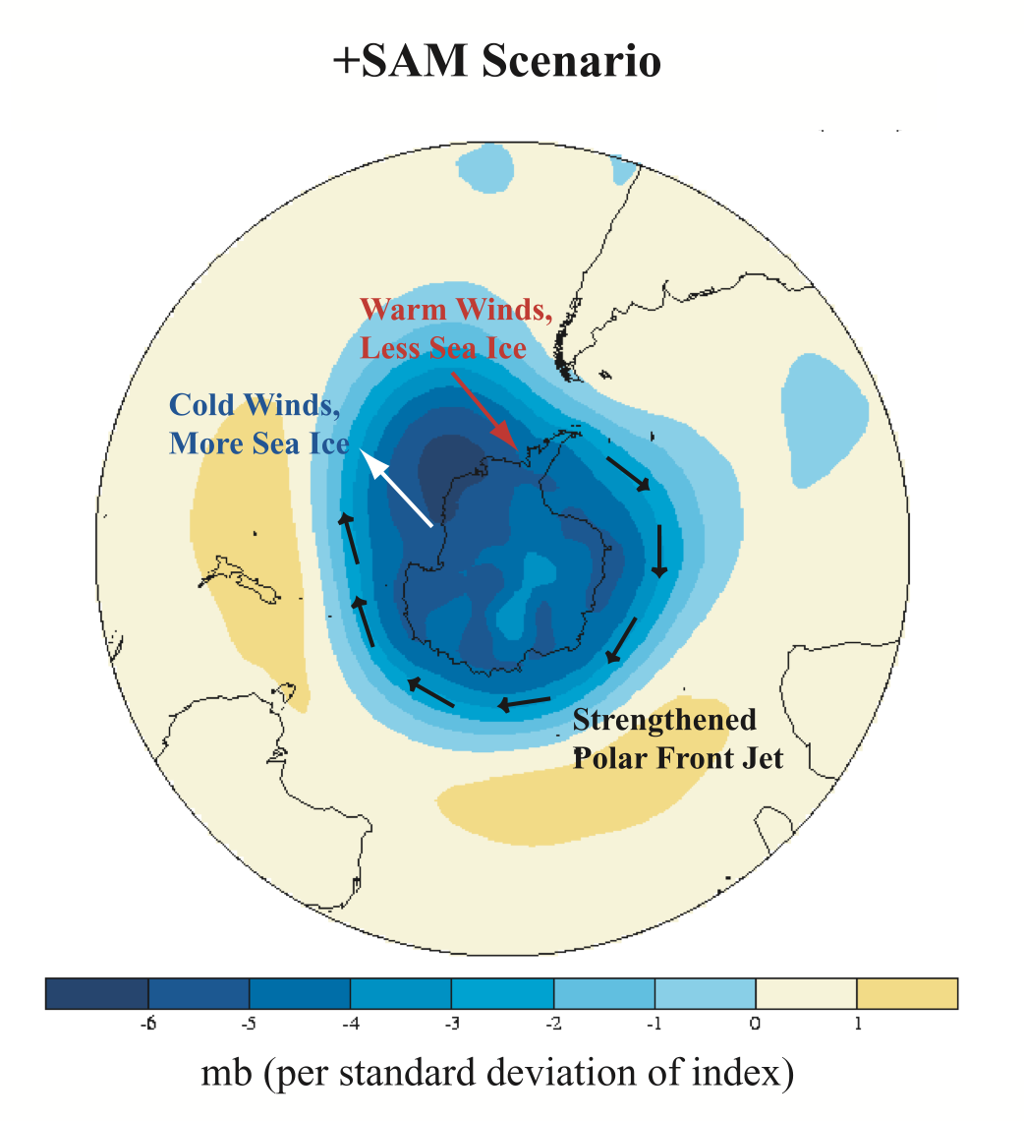
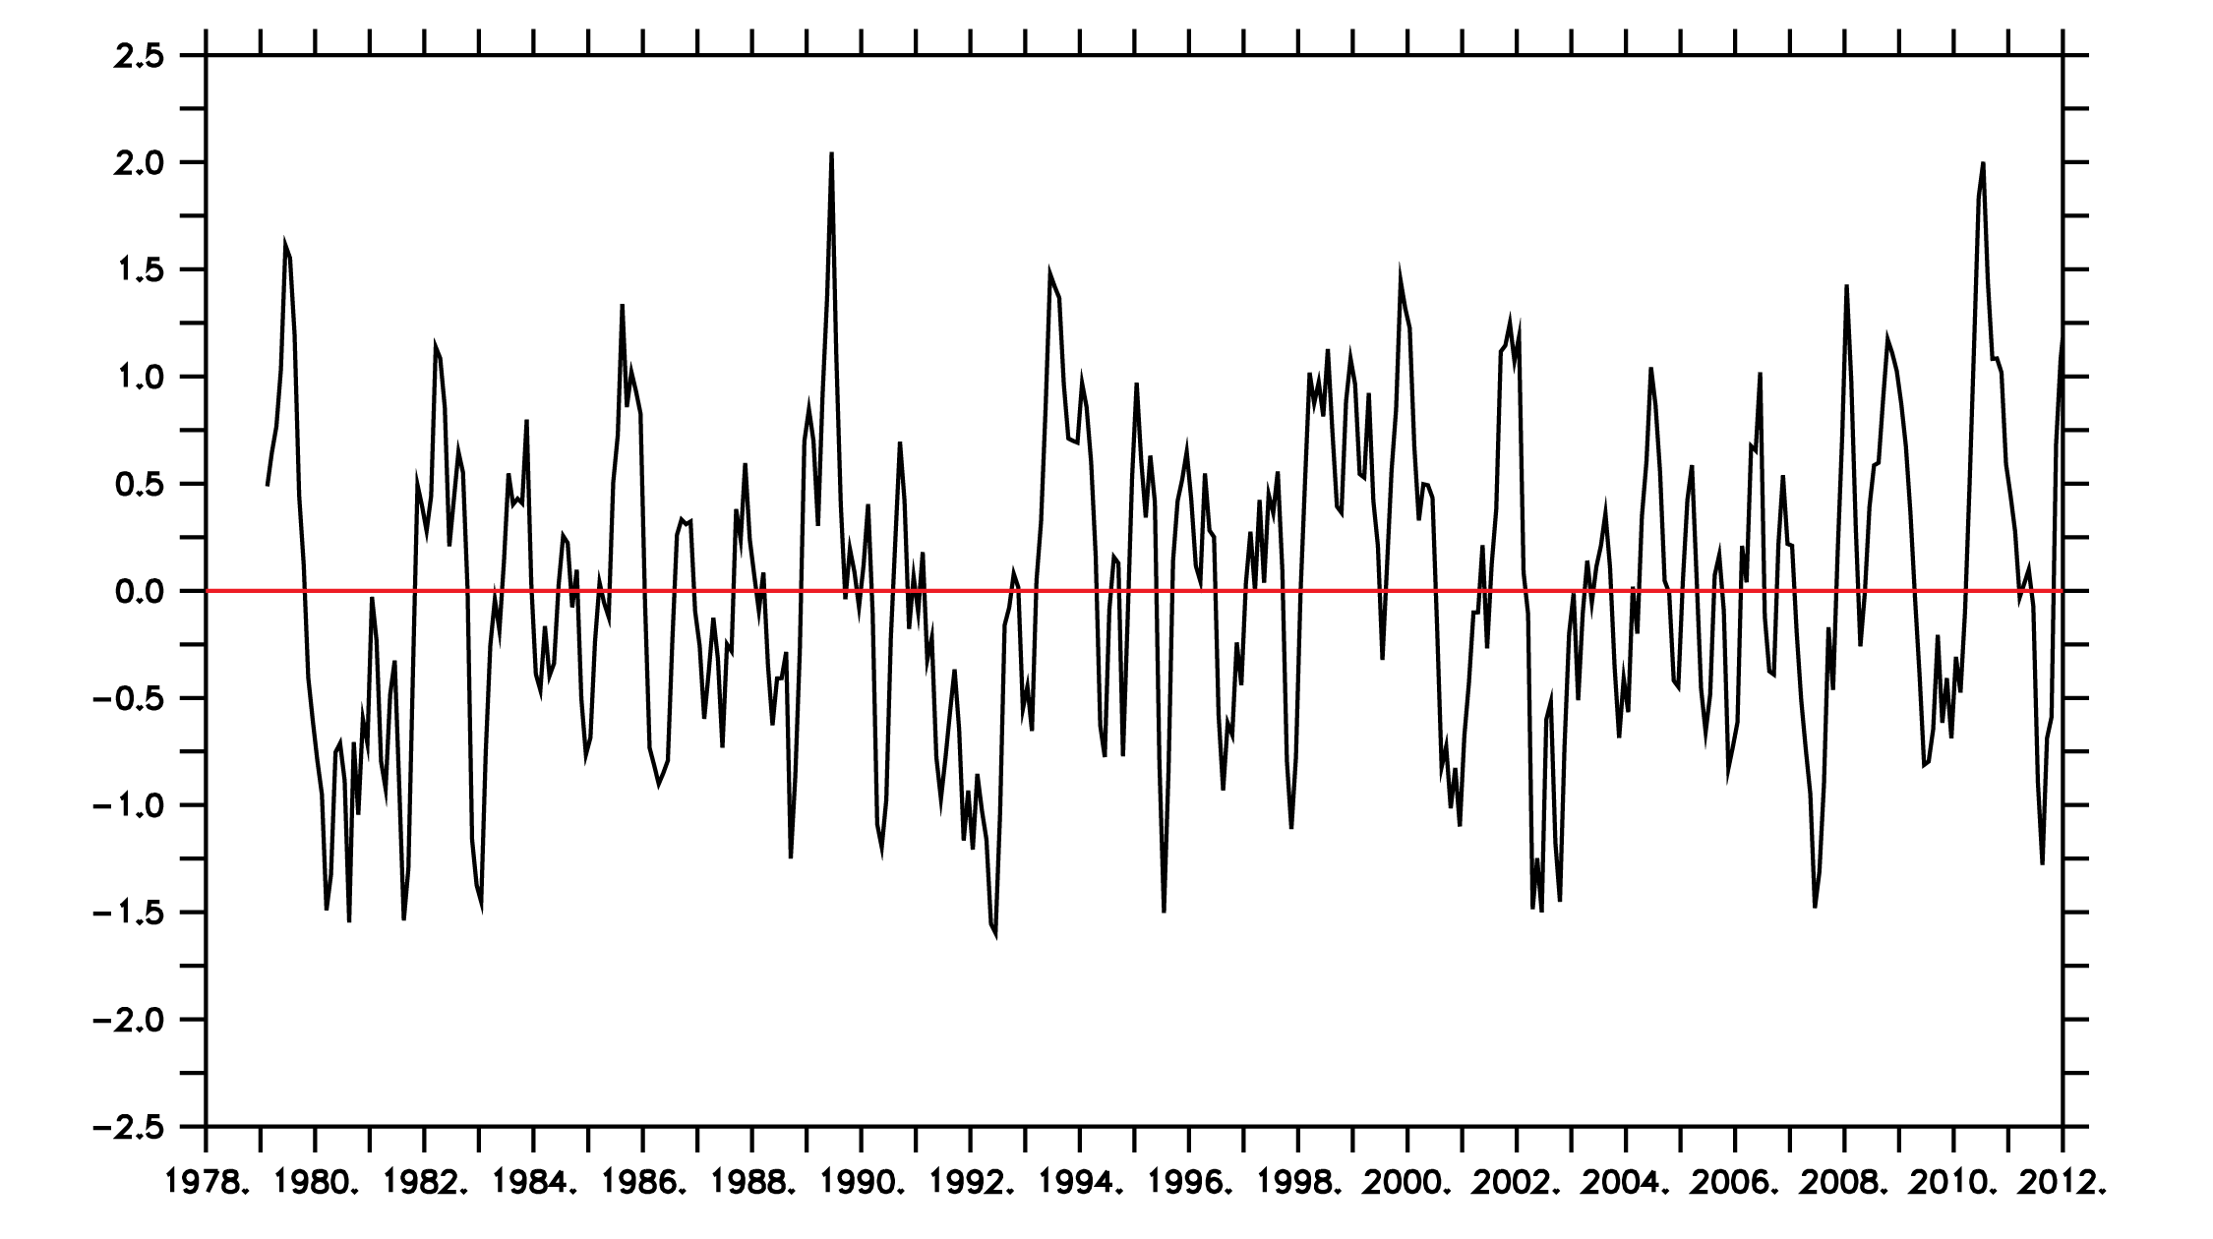
The Southern Annular Mode
High index SAM indicates an intensification and shift of the winds pole-ward
Upward trend in SAM over past century due to climate change
Stammerjohn et al., 2008
Notes:
3 month smoother applied to the SAM data, slow upward trend in the sam

Slide 7
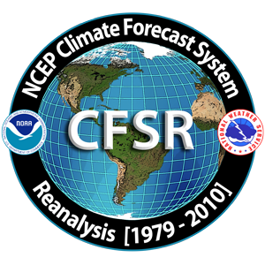

Methods
Data Sources
  Ice, local wind, and SST data obtained from the NCEP Climate Forecast System Reanalysis (CFSR) (http://cfs.ncep.noaa.gov/cfsr/)
  Southern Annular Mode (SAM) data obtained from NOAA Climate Prediction Center (http://www.cpc.ncep.noaa.gov/products/precip/CWlink/daily_ao_index/aao/aao.shtml)

Slide 8
Methods
Hypothesized the sea ice concentration in the Ross Sea and all the factors linked to ice formation/degradation were strongly linked to the SAM
  Created climatologies for the sea ice concentration, local winds, and SST
    Averaged all Januarys, Februarys, etc., for 30-year measuring period
  Correlated these climatologies with the SAM index
    Performed lead/lag analysis
Notes:
Local winds were correlated in the N-S direction, E-W direction, overall wind speed, and overall wind direction

Slide 9
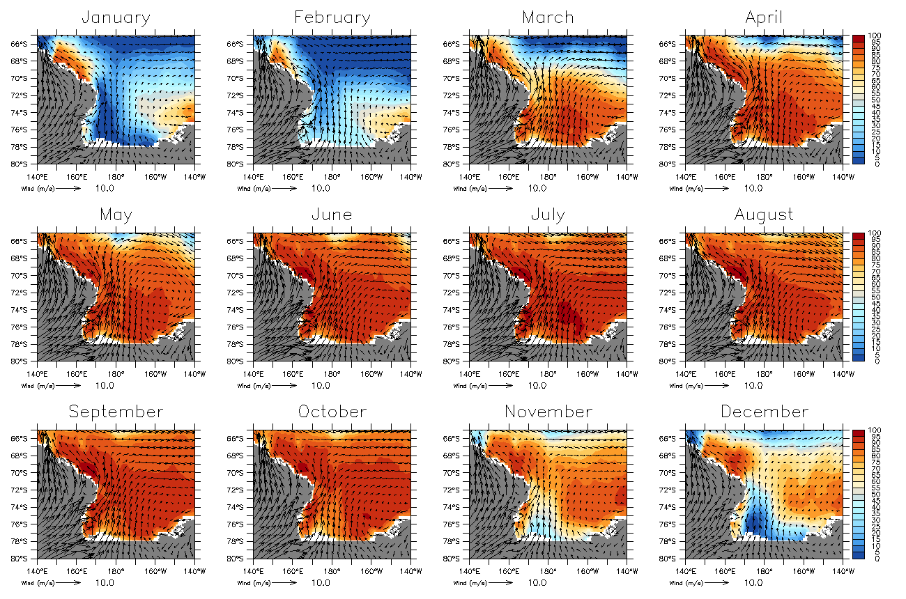
Average Sea Ice Concentration 1979-2009
Notes:
Average of all january, feb, march for 30 years
Warmer tones indicating higher sea ice coverage
Pronounced seasonal cycle – heaviest ice coverage in july during peak of winter, formation of polynas (large areas of ice-free water) in austral spring months of november and december produces melting in the austral summer months of january thru feb

Slide 10
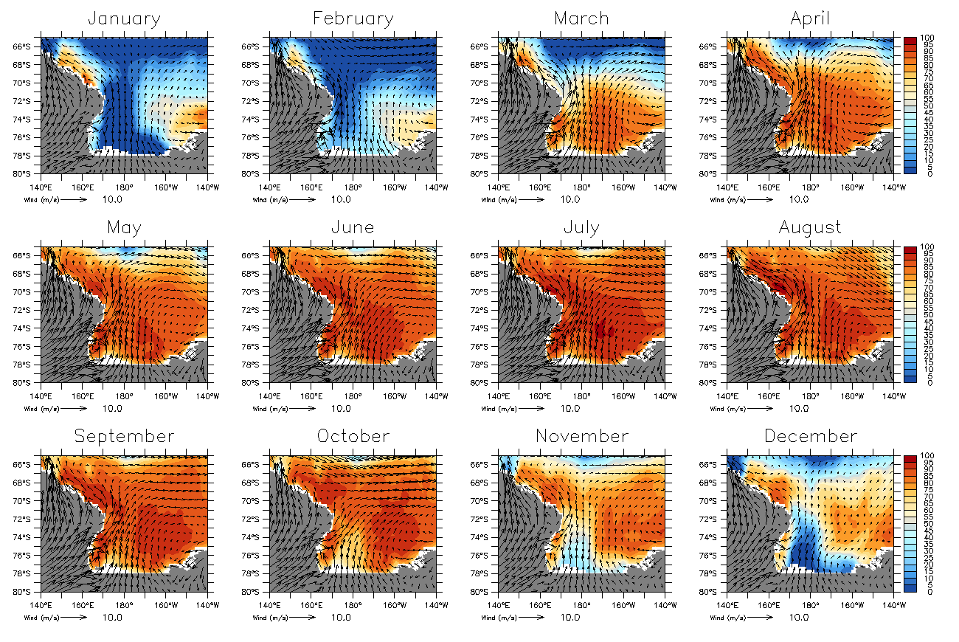
Average Sea Ice Concentration 1980 - 1989
Notes:
Climatologies for only the first ten years of data
Still significant ice coverage across all months

Slide 11
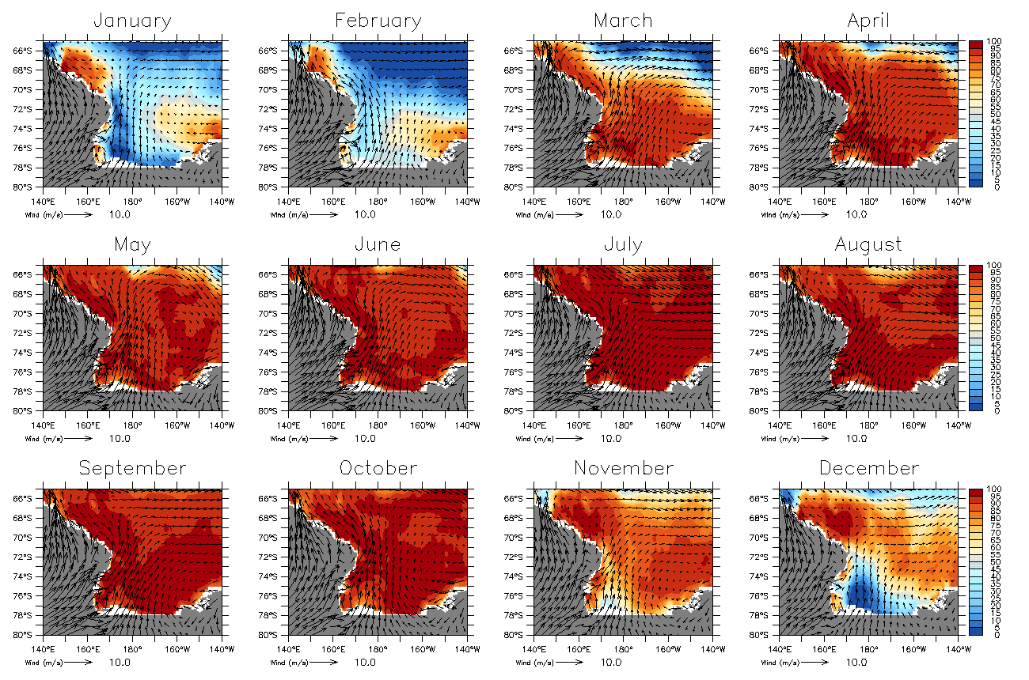
Average Sea Ice Concentration 2000 - 2009
Notes:
Climatologoies for the last ten years of data
Notice significant increase in ice across all months of the year
Melting occurs to happen later in the year – not starting until November but before had started in October. Also notice freezing starts earlier with more extensive coverage in March as compared to before

Slide 12
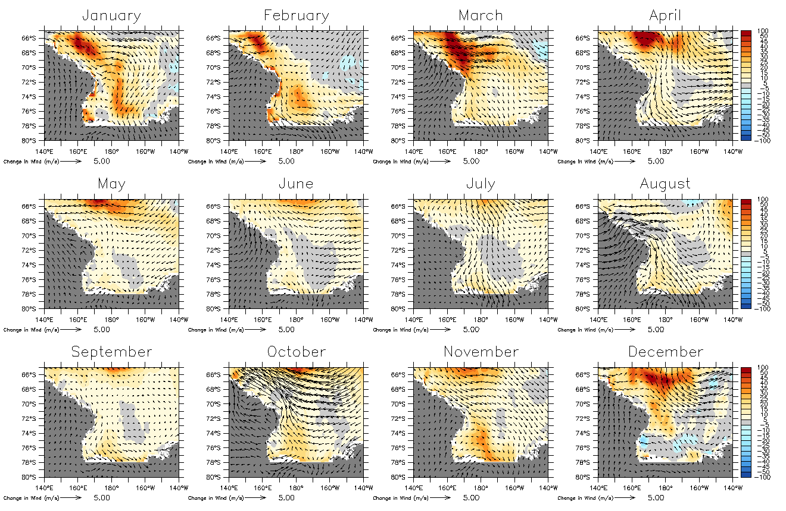
Differences in Sea Ice Coverage (Late – Early)
Notes:
Notice early extent of ice in march when ice refreezing is occurring, particularly the high concentration of ice in the higher latitudes
Notice delayed melting in November near the coast
Notice larger amount of ice remaining during the spring – especially December

Slide 13
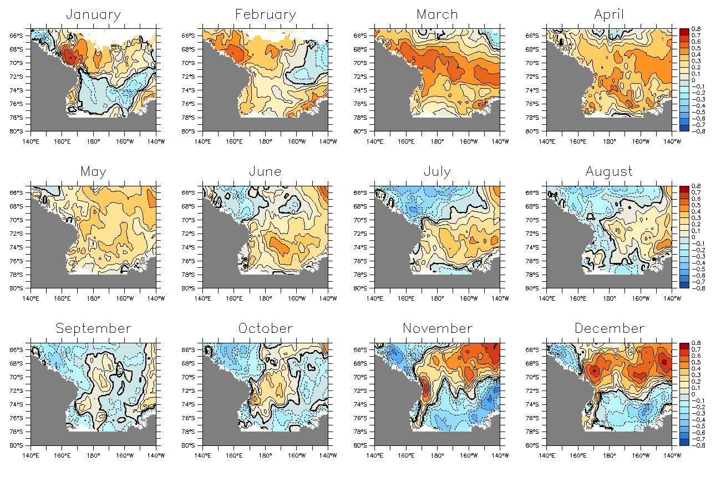
Correlation of SAM with Ice Conc. (SAM leading by 1 month)
Notes:
Higher index SAM in autumn (march - june) leads to quicker ice growth
Higher index SAM in spring (Nov – Dec) leads to more advection of ice away from the coast, and therefore exposes open water near shore that quickly refreezes

Slide 14
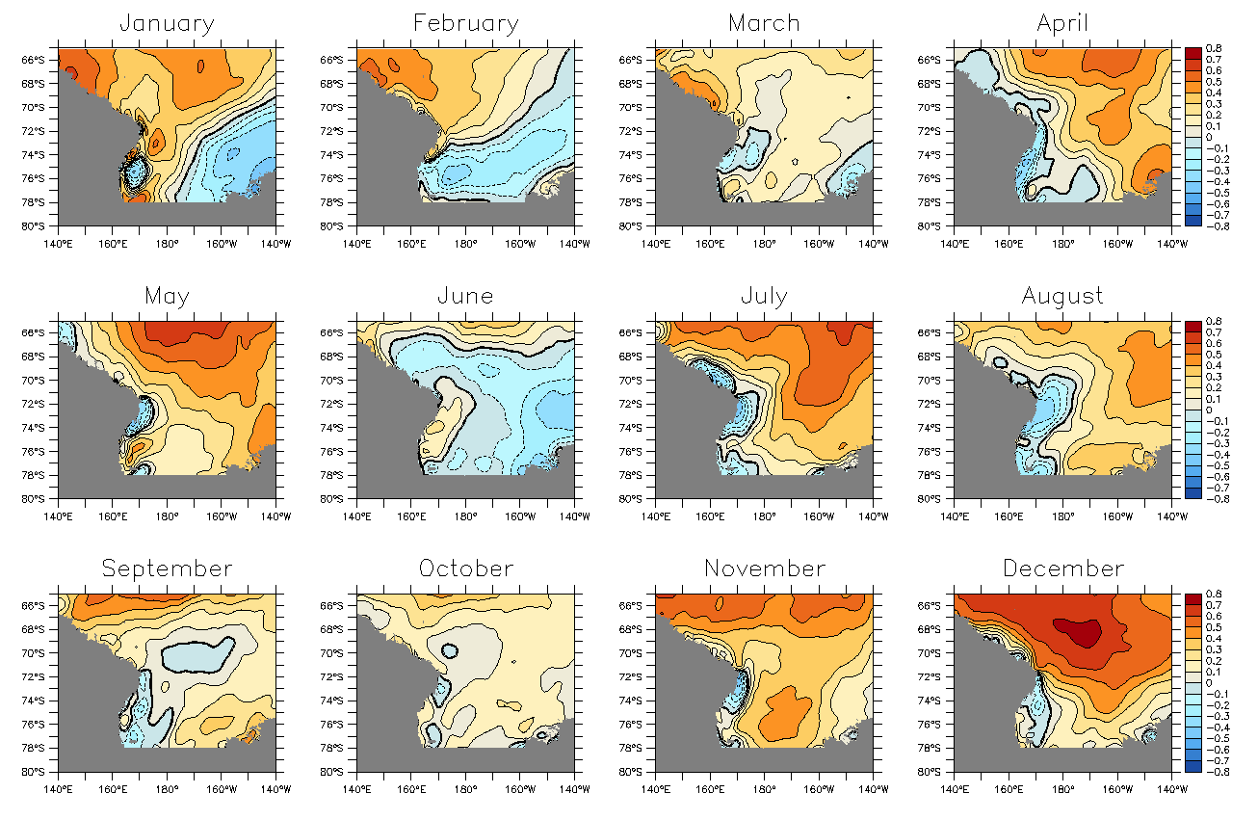
Correlation of SAM with Zonal Wind Anomaly
Notes:
High index SAM is correlated with strong westerly winds at the higher latitudes. Stronger westerlies subsequently lead to a stronger Ekman transport of ice away from the shelf, exposing open water to cold air so that it quickly refreezes.

Slide 15
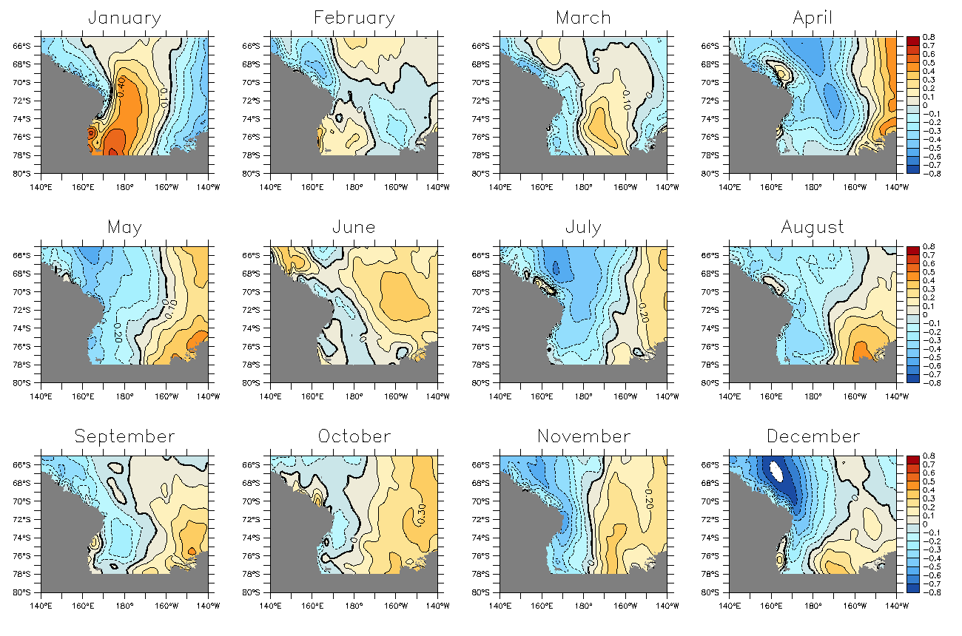
Correlation of SAM with Meridional Wind Anomaly
Notes:
High index SAM is correlated to increased southerly winds near the ice shelf, which advects ice away from the shelf. It then exposes the open water to cold, dense katabatic winds coming off the antarctic continent which quickly refreezes the water

Slide 16
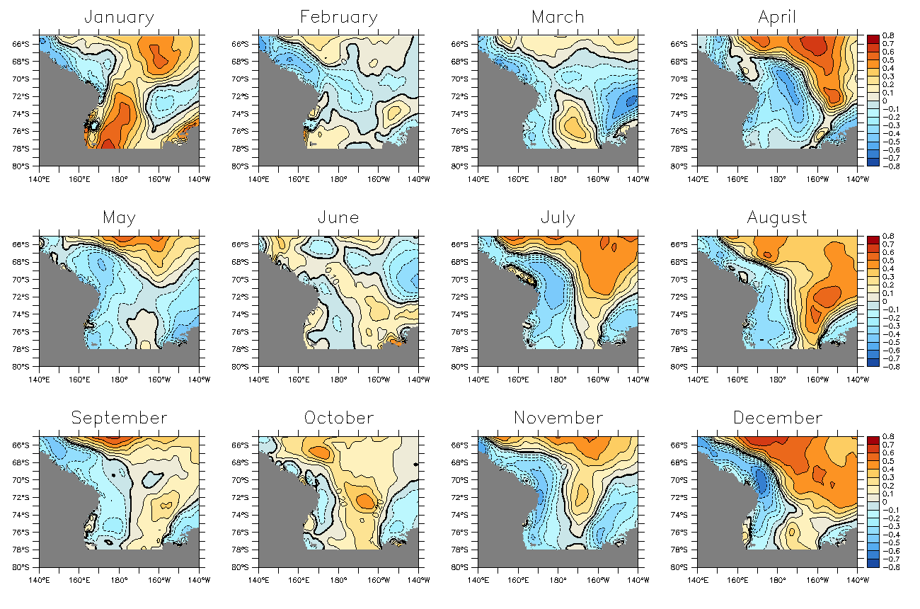
Correlation of SAM with Wind Speed Anomaly
Notes:
Increased wind speeds off shore increase the force of ekman transport as well as pushes ice away from the shelf. Both these actions serve to expose new open water to cold, dense air, resulting in the continual freezing of ice near the shelf

Slide 17
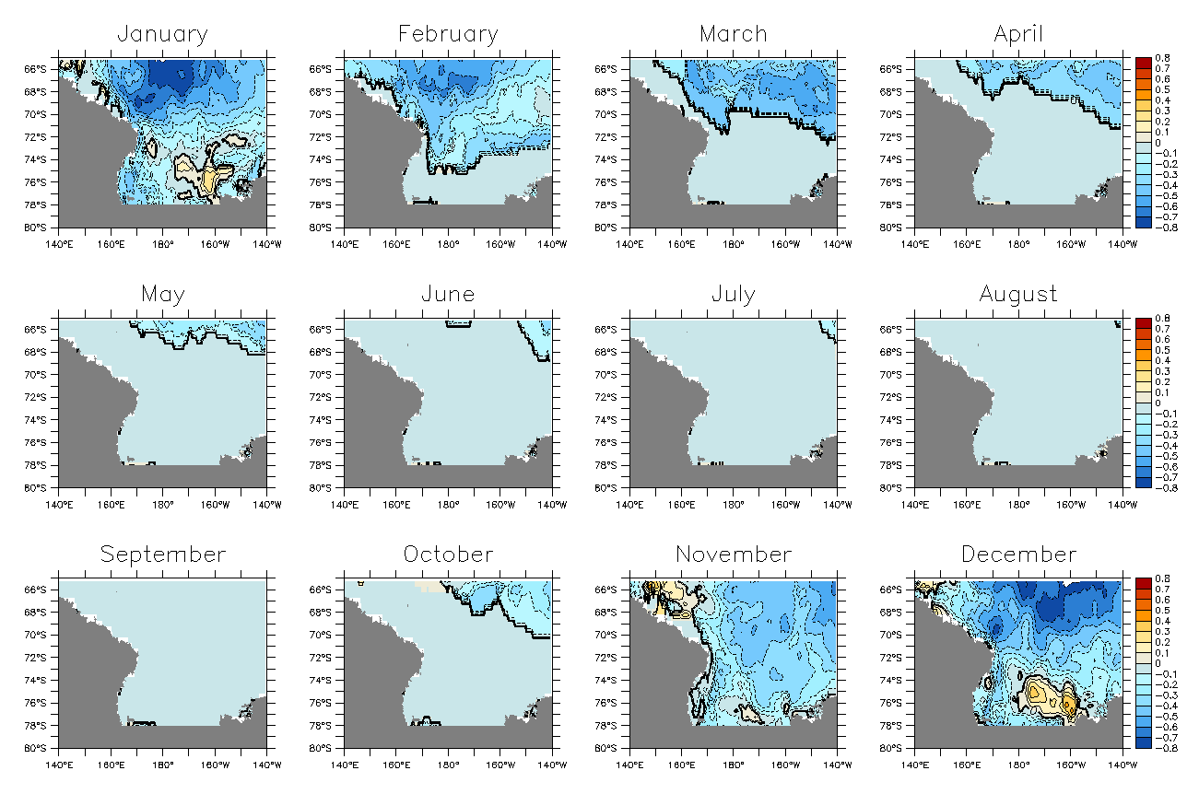
Correlation of SAM with SST
(SST leading by 1 month)
Notes:
Throughout most months the sst data was not obtainable because of the presence of the ice pack
In spring and summer, however, a high SAM leads to greater upwelling of cold water near the coast. This water warms the ice to form large polynas near the shore and begin the melting of the ice. However, advection of warmer water to the surface does not happen off shore where the ice persists and withstands melting.

Slide 18
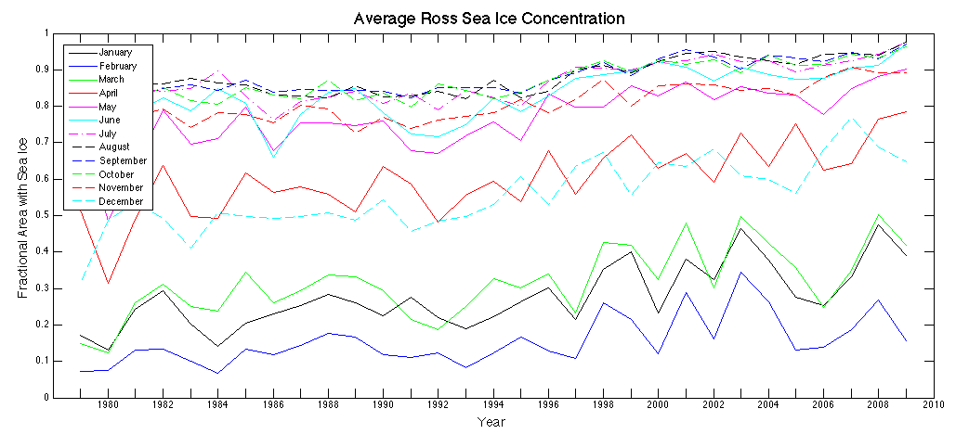
Areal Coverage by Ice in the Ross Sea
There has been an upward trend in the sea ice concentration in the Ross Sea across all months.

Slide 19
Conclusions
The Ross Sea is getting colder!
High index SAM produces a conveyor belt of ice in the Ross Sea
Increased ice growth is cause by advection of ice out of the Ross Sea by katabatic winds and Ekman transport
Open water near coast is quickly frozen when contacted by cold, dense, katabatic winds
http://images.search.yahoo.com/search/images?p=antarctica%20wallpaper

Slide 20
Acknowledgements
Thank you to the Arizona/NASA Space Grant Consortium for funding this research. We also acknowledge the Data Support Section of the Computational and Information Systems Laboratory at the National Center for Atmospheric Research (http://dss.ucar.edu) for providing access to the CFSR data.
http://artsonearth.com/2010/05/antarctica-versus-global-warming.html

